Slide 1

New Horizon Institute of Technology and Management, Thane
Department of Computer Engineering
BMI Calculator
By Dinkal Chavan Nilesh Chavhan Jayesh Dalvi
IEN: 12312024
IEN:12212076
IEN:12312068
Guided by: Ms Pallavi N Patil

Slide 2
Problem Statement and Objectives
Problem statement: To Develop a program to calculate the Body Mass Index (BMI) based on a user's weight and height, and determine their health status using BMI categories.
Objectives:
To create a program that calculates Body Mass Index (BMI) based on user input for weight and height.
To classify the user's BMI into standard health categories (e.g., underweight, normal weight, overweight, obesity).
To provide clear output indicating the user's BMI and associated health status.
To ensure accurate handling of inputs [metric(kg , cm) / Imperial(lbs , inches)].
To enhance the user's understanding of their health based on BMI measurements.
BMI Calculator

Slide 3
Workflows
Start/Initialize
Login username and gender
Select the metric or Imperial units
Get user Input:
-Weight
-Height
Calculate BMI in real-time
Based on formula
BMI =weight/(height^2)
Check BMI Range and
Assign Health Category
End
For more details
Contact doctor
Display Results with Health advice
BMI Calculator

Slide 4
Implementation Details
To implement a simple BMI (Body Mass Index) calculator , you can follow these steps. Below is the breakdown Steps for Implementation:
Home page:
Contains the description and features of BMI.
It also contain Login box which user should provide username and gender.
Collect Input:
Input the user's weight in [metric(kg , cm) / Imperial(lbs , inches)].
Input the user's height in [metric(kg , cm) / Imperial(lbs , inches)].
Calculate BMI:
Formula: BMI = weight / (height * height).
Display BMI:
Based on the calculated BMI, display the BMI value.
BMI Calculator

Slide 5
Categorize BMI:
Underweight: BMI < 18.5
Normal weight: 18.5 ≤ BMI < 24.9
Overweight: 25 ≤ BMI < 29.9
Obesity: BMI ≥ 30
Display BMI & health advice:
The result of BMI is displayed provided with health advice by expertise.
Consult Doctor:
For more detail description contact doctor is provided
where Dr. Pooja Sharma will be available.
BMI Calculator

Slide 6
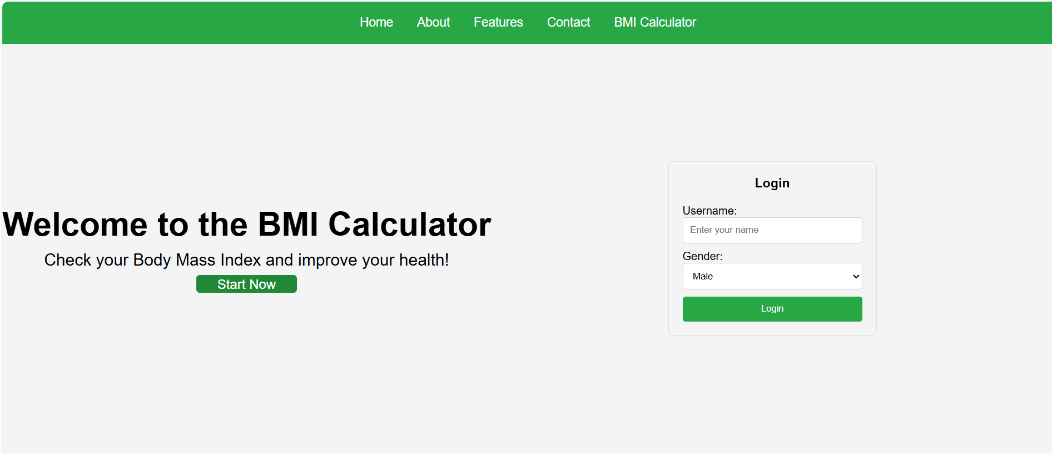
Result Screenshot
Welcome page
BMI Calculator

Slide 7
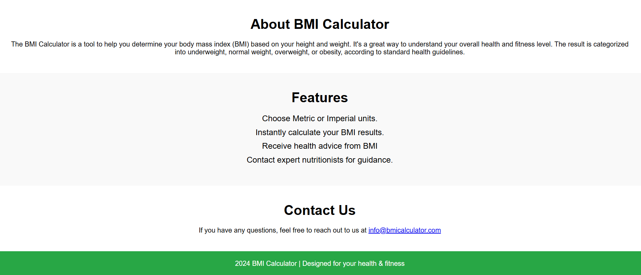
BMI Calculator

Slide 8
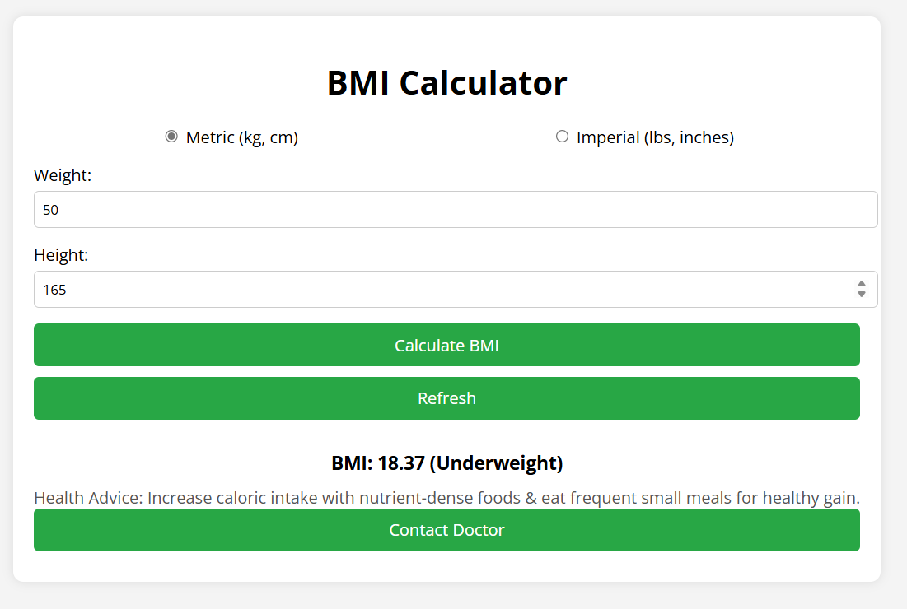
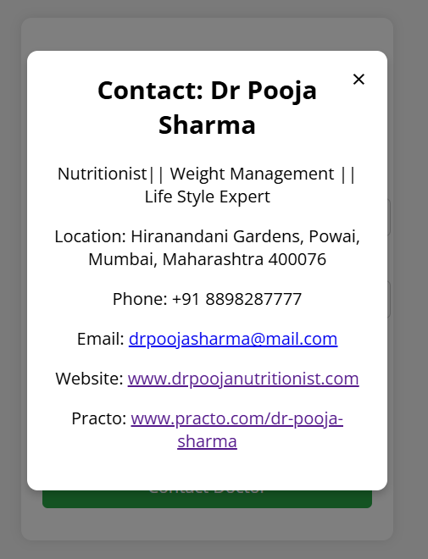
BMI Calculator
Contact Doctor if required
BMI Calculator

Slide 9
References
Smith , John. *Health and Fitness: Understanding BMI*.3rd Edition, Wellness Press,2019. This citation is useful for referencing detailed discussions on the concept of BMI, its significance, and how it relates to overall health and fitness.
World Health Organization. “Body Mass Index (BMI).” This reference provides authoritative information on BMI classifications, their role in assessing health risks, and their global usage as a standard for understanding weight categories.
MDN Web Docs. “HTML Forms –Structure and Usage.”-This source provides essential guidance on the creation and structure of HTML forms, which was instrumental in building user-friendly forms for collecting data, such as height and weight, in the BMI calculator.
W3Schools. “CSS Styling Basics.”- This source was used for learning both basic and advanced CSS techniques, which helped in designing the layout and visual interface of the BMI calculator, ensuring a responsive and user-friendly design.
Codecademy. “JavaScript Interactive Web Pages.”-This resource provided valuable insights into adding JavaScript interactivity, which was essential for implementing real-time BMI calculation and display functionality in the BMI calculator.
BMI Calculator

Slide 10
THANK YOU

